Slide 1
Speech Emotion Recognition
Yashwardhan Singh Ranawat & Jishnu Moorthy

Slide 2
Breakdown of Datasets
RAVDESS : Ryerson Audio-Visual Database of Emotional Speech and Song
24GB , 1440 audio files (60 trials per actor x 24 actors)
12 female and 12 male actors, Neutral North American Accent
Sentences expressed in two levels : strong, normal.
Emotions : calm, happy, sad, angry, fearful, surprise, and disgust expressions.
SAVEE : Surrey Audio-Visual Expressed Emotion
259MB
Four native English male speakers (identified as DC, JE, JK, KL) in 7 emotions
Phonetically balanced for each emotion
Emotions: anger, disgust, fear, happiness, sadness and surprise
CREMA – D : Crowd-sourced Emotional Multimodal Actors Dataset
7,442 clips of 91 actors with diverse ethnic backgrounds
African America, Asian, Caucasian, Hispanic, and Unspecified
Emotions: happy, sad, anger, fear, disgust, and neutral

Slide 3
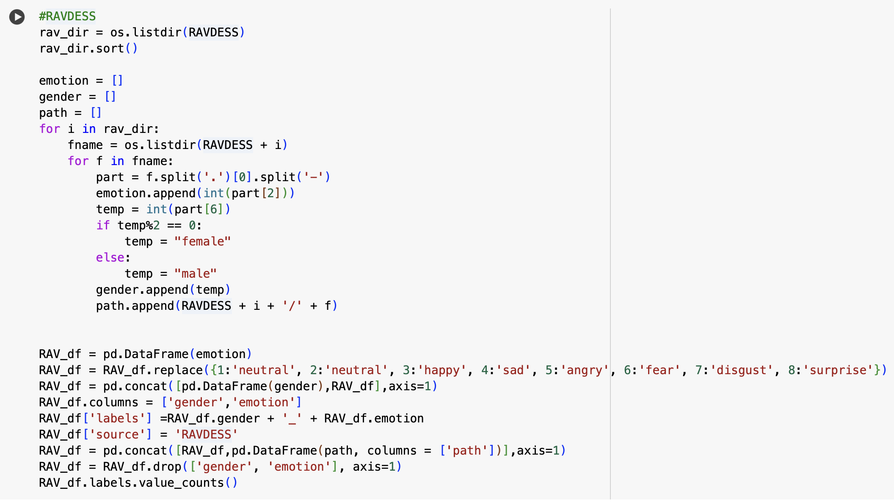
Processing and Combining Datasets
File Path Example : ACTOR_01 → 03-01-01-01-01-01-01.wav

Slide 4
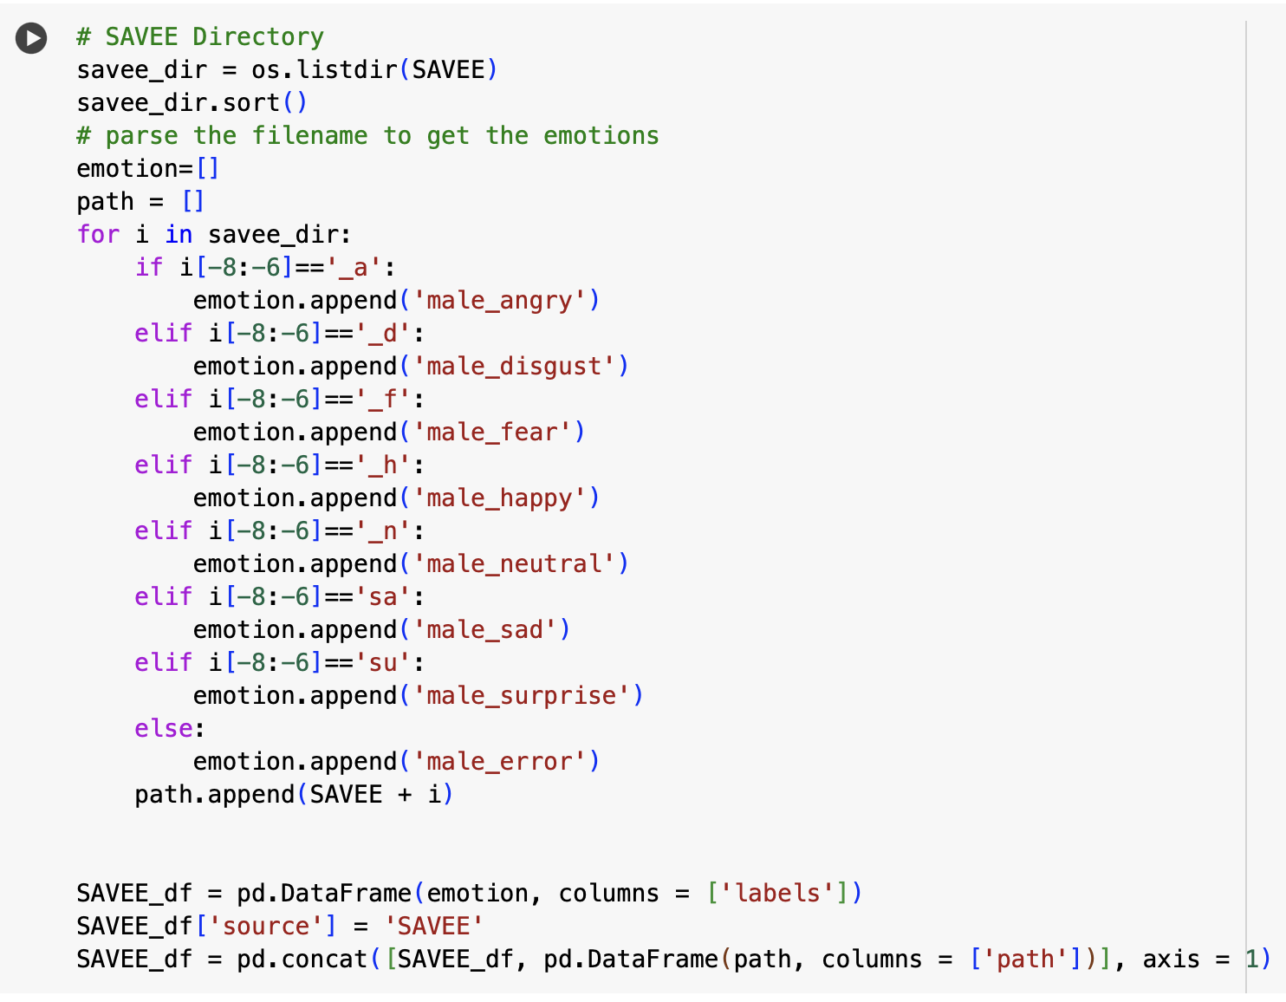
Processing and Combining Datasets
File Path Example : DC_a01.wav

Slide 5
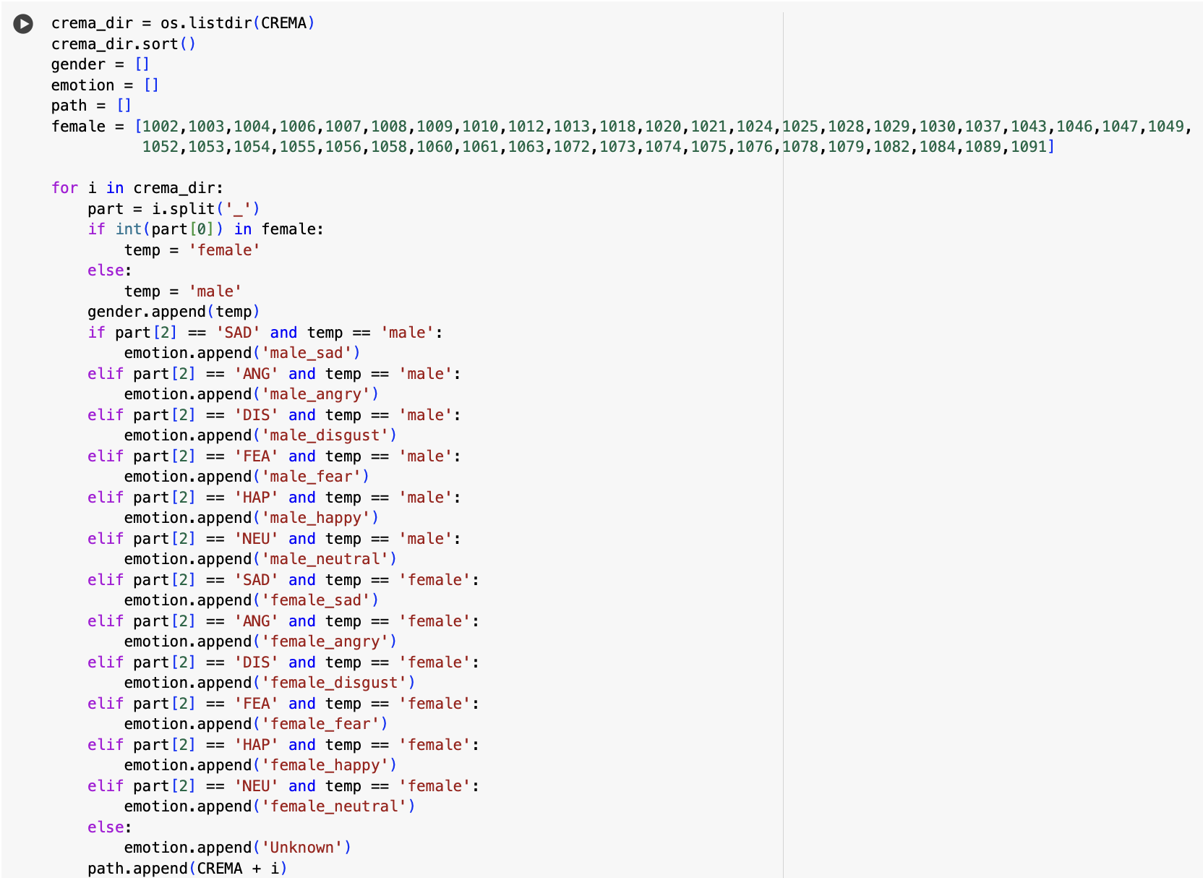
Processing and Combining Datasets
File Path Example : 1001_DFA_ANG_XX.wav

Slide 6
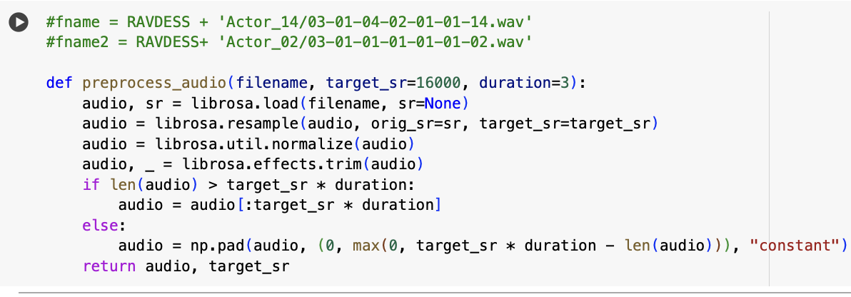
Resampling Audio
Sampling Rate : Number of audio samples taken per second when digitizing an analog audio signal. It is a crucial parameter for digital audio processing.
Real-world speech emotion datasets contain audio files recorded at different sampling rates, which can vary from 8 kHz to 48 kHz or higher.
Higher samples → more samples per second → better digitized audio → consistent input format
For example, a sampling rate of 44.1 kHz means 44,100 audio samples are taken every second

Slide 7
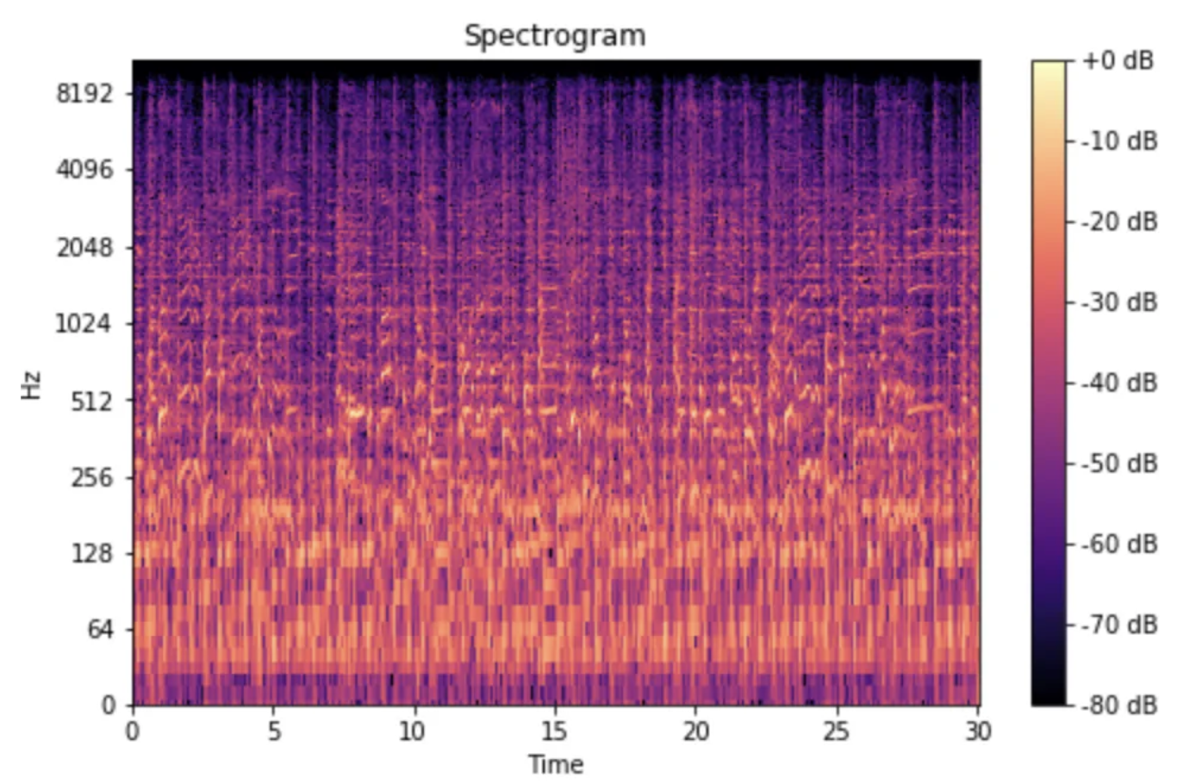
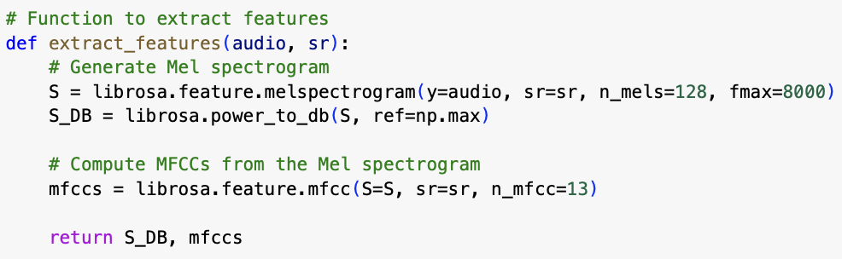
Feature Extraction
Mel-Frequency Spectrogram:
MFCC (Mel-frequency cepstral coefficients) : Widely used representation of audio signals that captures the spectral characteristics of sound in a way that aligns with human auditory perception.
Set of 13 to 40 coefficients is computed, each capturing different aspects of the sound's frequency content.

Slide 8
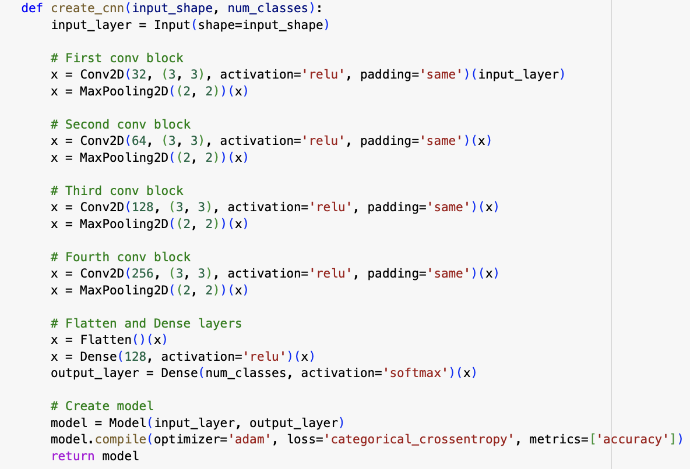
CNN Model

Slide 9
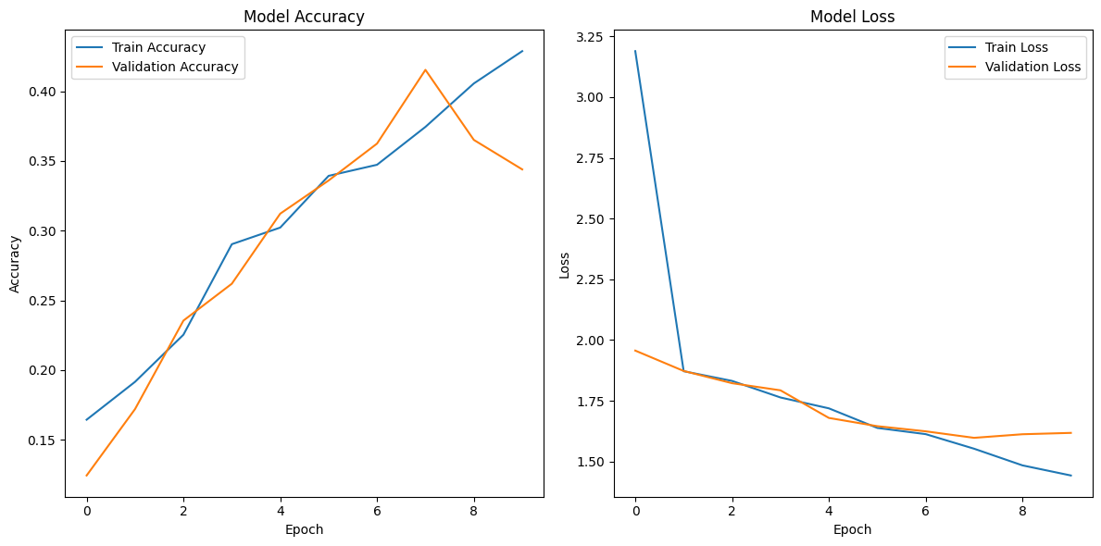
CNN Deep Learning Model
Took a 20% sample of the original dataset to run the model on collab.

Slide 10
Next Steps…
Data Augmentation:
Noise Injection
Shifting Time
Changing Speed
Changing Pitch
Hyperparameter Tuning
Implement LSTM Model
Transfer learning & Pre-Trained Model
YAMnet
Open AI’s Whisper
Evaluation of Models
Deployment (Possibly)

